Slide 1
Gabriel Galeote Checa
Project Flexible, Biocompatible, and Wirelessly Powered Implantable Optoelectronics | What I did last four weeks? Design final version of the circuit. Design antenna Write abstract for conference paper Developed conceptual model of the device.
Problem being faced? ANTENNA | What to do in next two weeks? Find a solution for the antenna. Final etching of the device.

Slide 2
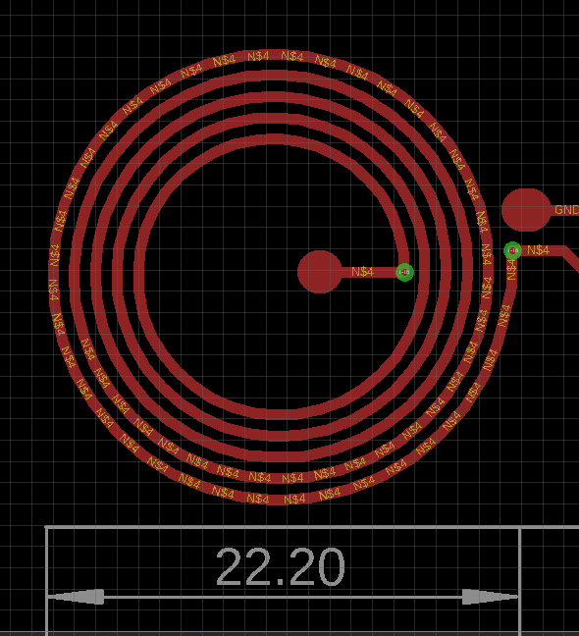
Bioimplantable Device
1. Current work
Antenna Designed
Parameters:
Number of turns = 5
wire width = 0.5 mm
Spacing = 0.5 mm
Outer Diameter = 22.2 mm
Inner Diameter = 12.3 mm

Slide 3
Bioimplantable Device
1. Current work
Planify tests for the final circuit:
Which tests to run?
What to measure?
Which environment to use?
Planify testing phase
Main points of the implant:
Modularity
Long shank (or variable shank)
Flexibility
Wireless Power Transmission (WPT)
Prepare conference Paper

Slide 4
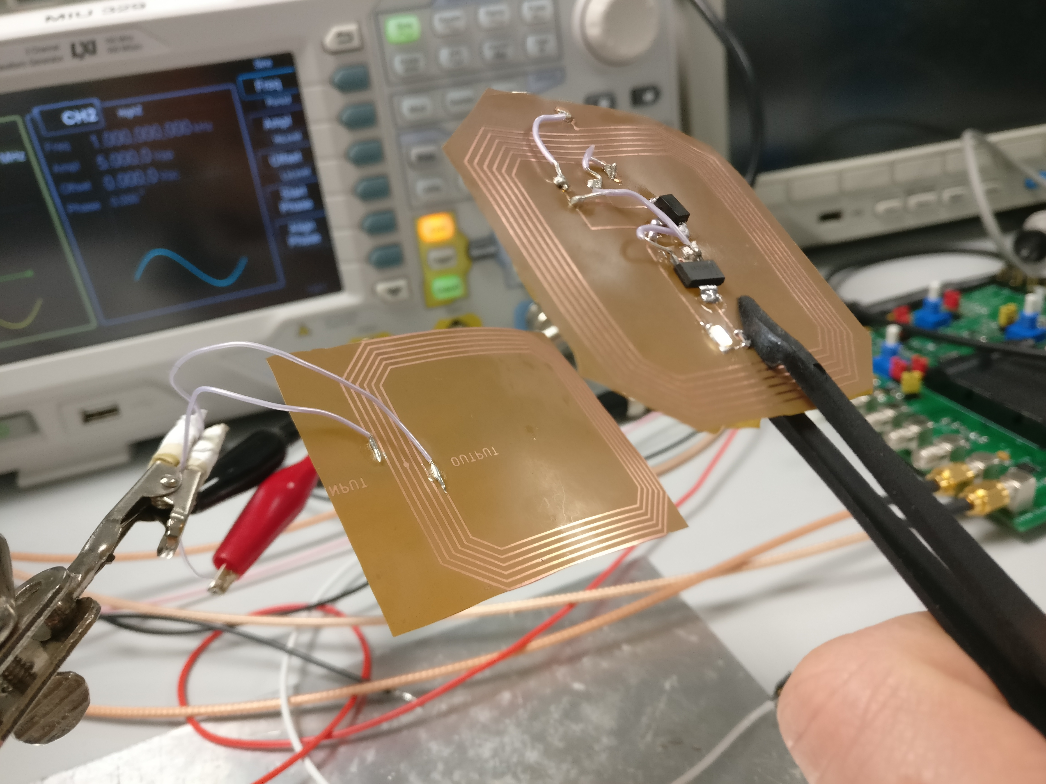
Bioimplantable Device
2. Experimental Results
Resonant frequency → around 8 MHz
Using 10 Vpp (5V amplitude)
Tested in diferent angles and curvatures

Slide 5
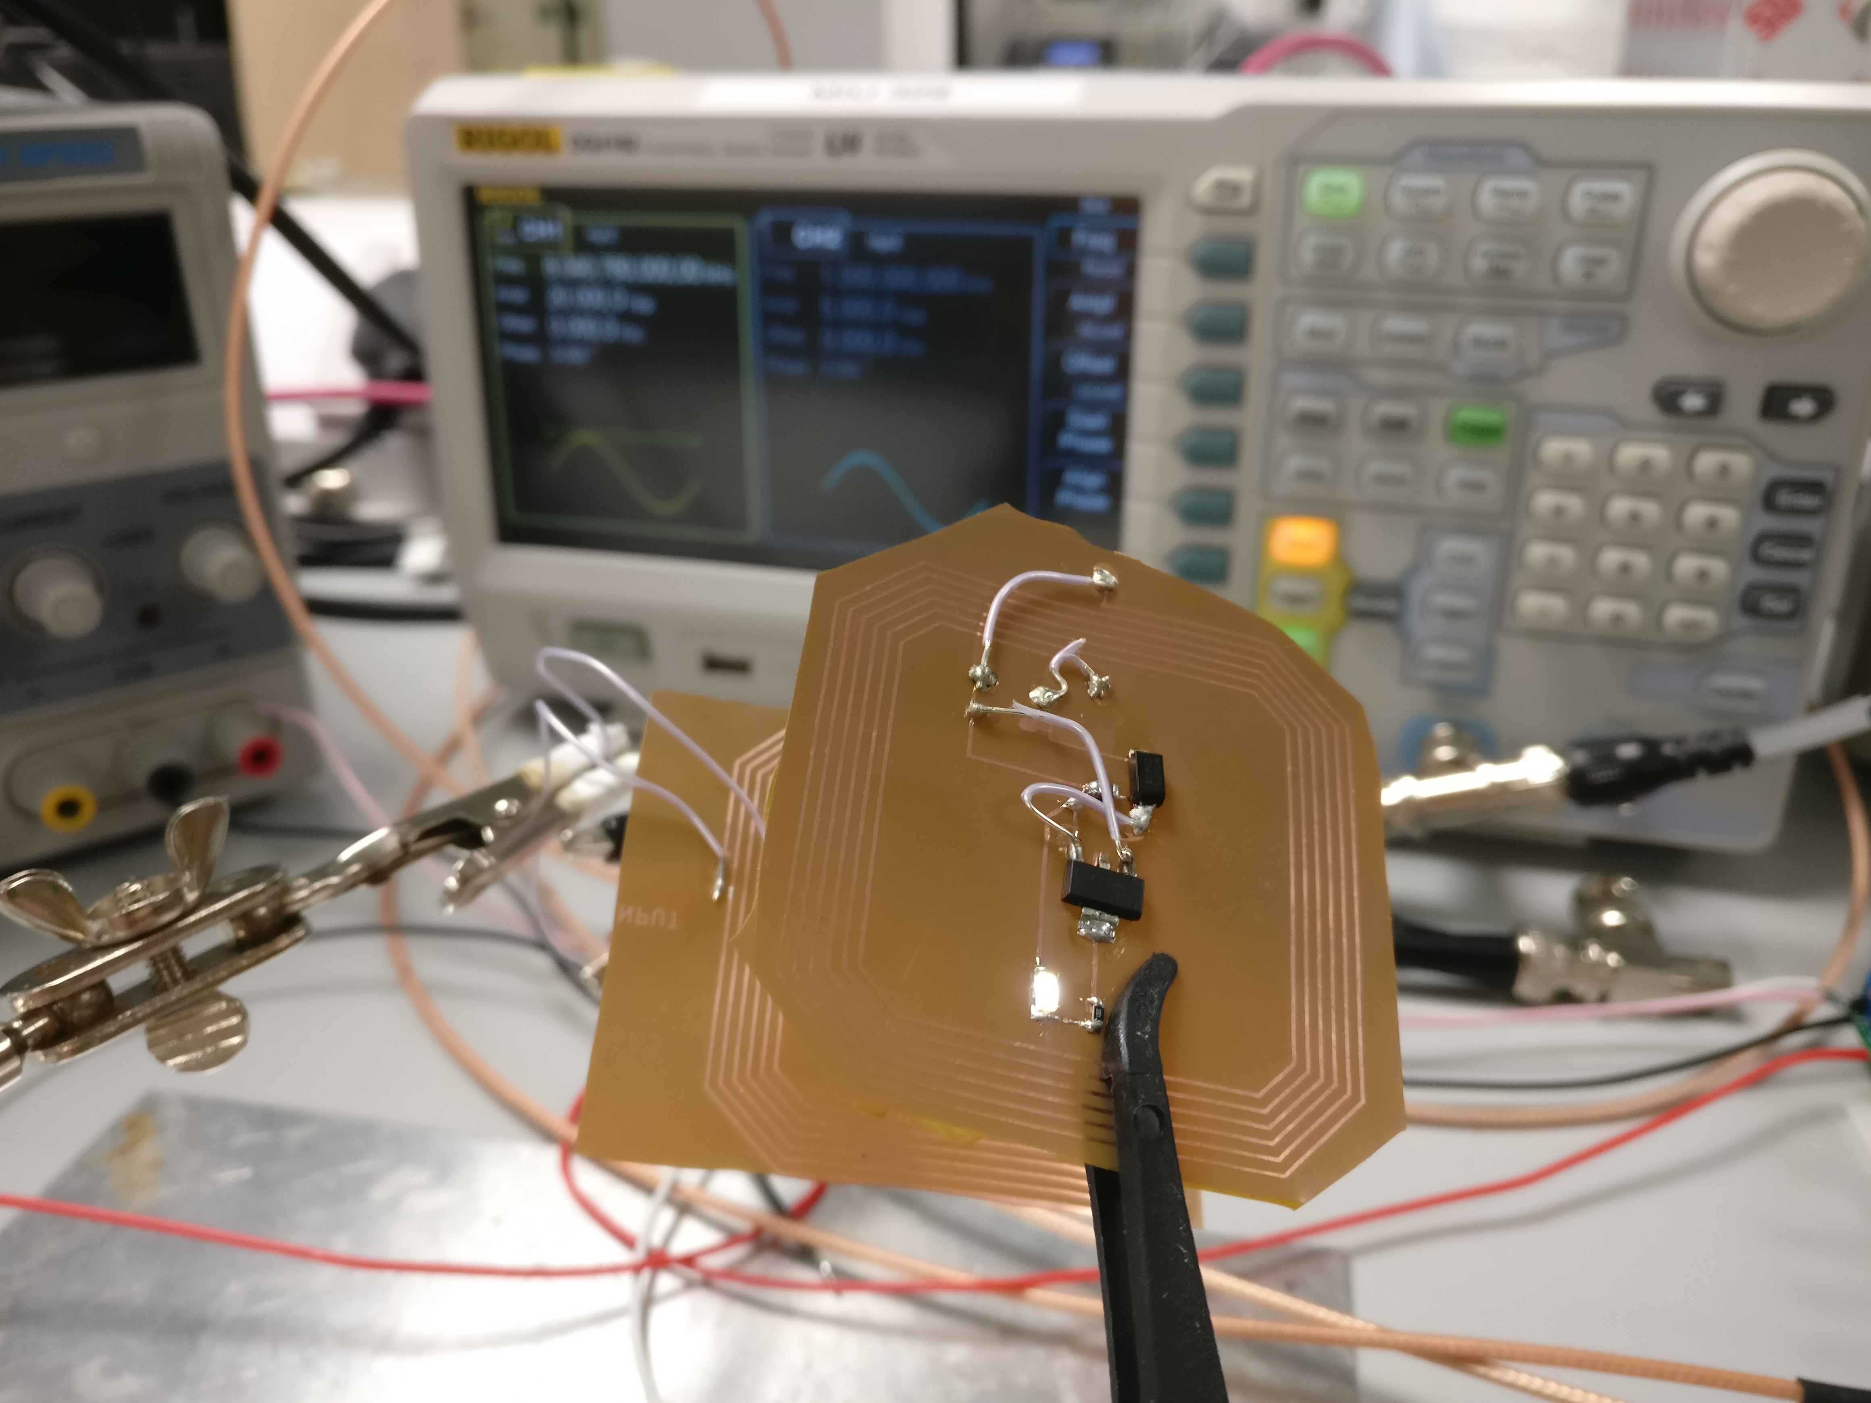
Bioimplantable Device
2. Experimental Results
Not tunned antenna

Slide 6
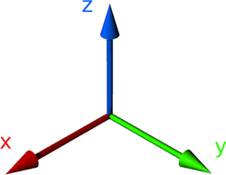
Bioimplantable Device
2. Experimental Results
The antena firstly needs to be coupled with the primary coil. Then, we can move the antena to a certain reange and rotate it in XYZ axis.
The power on the led seems to remain stable thanks due to the LDO Voltage regulator. However, I need a way to measure the power while I am moving the antenna in different angles and distances to corroborate that the performance is correct despite the geometrical factor

Slide 7
Bioimplantable Device
3. Next steps
Order primary coil (13.56 MHz)
Tune antena with capacitance
In case that in two weeks we are not able to tune the capacitance, we will use a comercial secondary coil (13.56 MHz) for the testing
Start Testing Phase
Rotations over XYZ in the magnetic field.
Propagation distance.
Performance in saline solution.
Using an material with some electromagnetic mitigation between antenna and implant.
The effect on the emitted light using different resistances.

Slide 8
Bioimplantable Device
3. Next steps
Order primary coil (13.56 MHz)
Tune antena with capacitance
In case that in two weeks we are not able to tune the capacitance, we will use a comercial secondary coil (13.56 MHz) for the testing
Start Testing Phase
Rotations over XYZ in the magnetic field.
Propagation distance.
Performance in saline solution.
Using an material with some electromagnetic mitigation between antenna and implant.
The effect on the emitted light using different resistances.

Slide 9
Bioimplantable Device
Feedback
Should I change the frequency of the implant if Welektronik cannot provide us a transmitter coil for 13.56 MHz?
Should I just use the 8 MHz antena that I am already using for the tests or should I wait until I have the final design?
Any recommendations of how to test the power of the antena transmission?

Slide 10
Bioimplantable Device
Thank for the attention

